Slide 1

Cyber Defense Organization
Fall 2018 - Firewalls

Slide 2
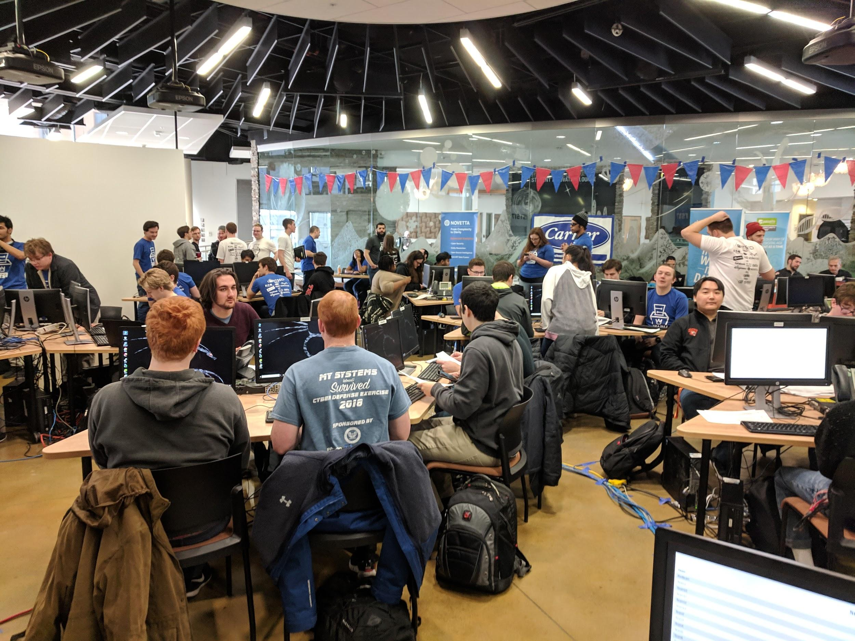
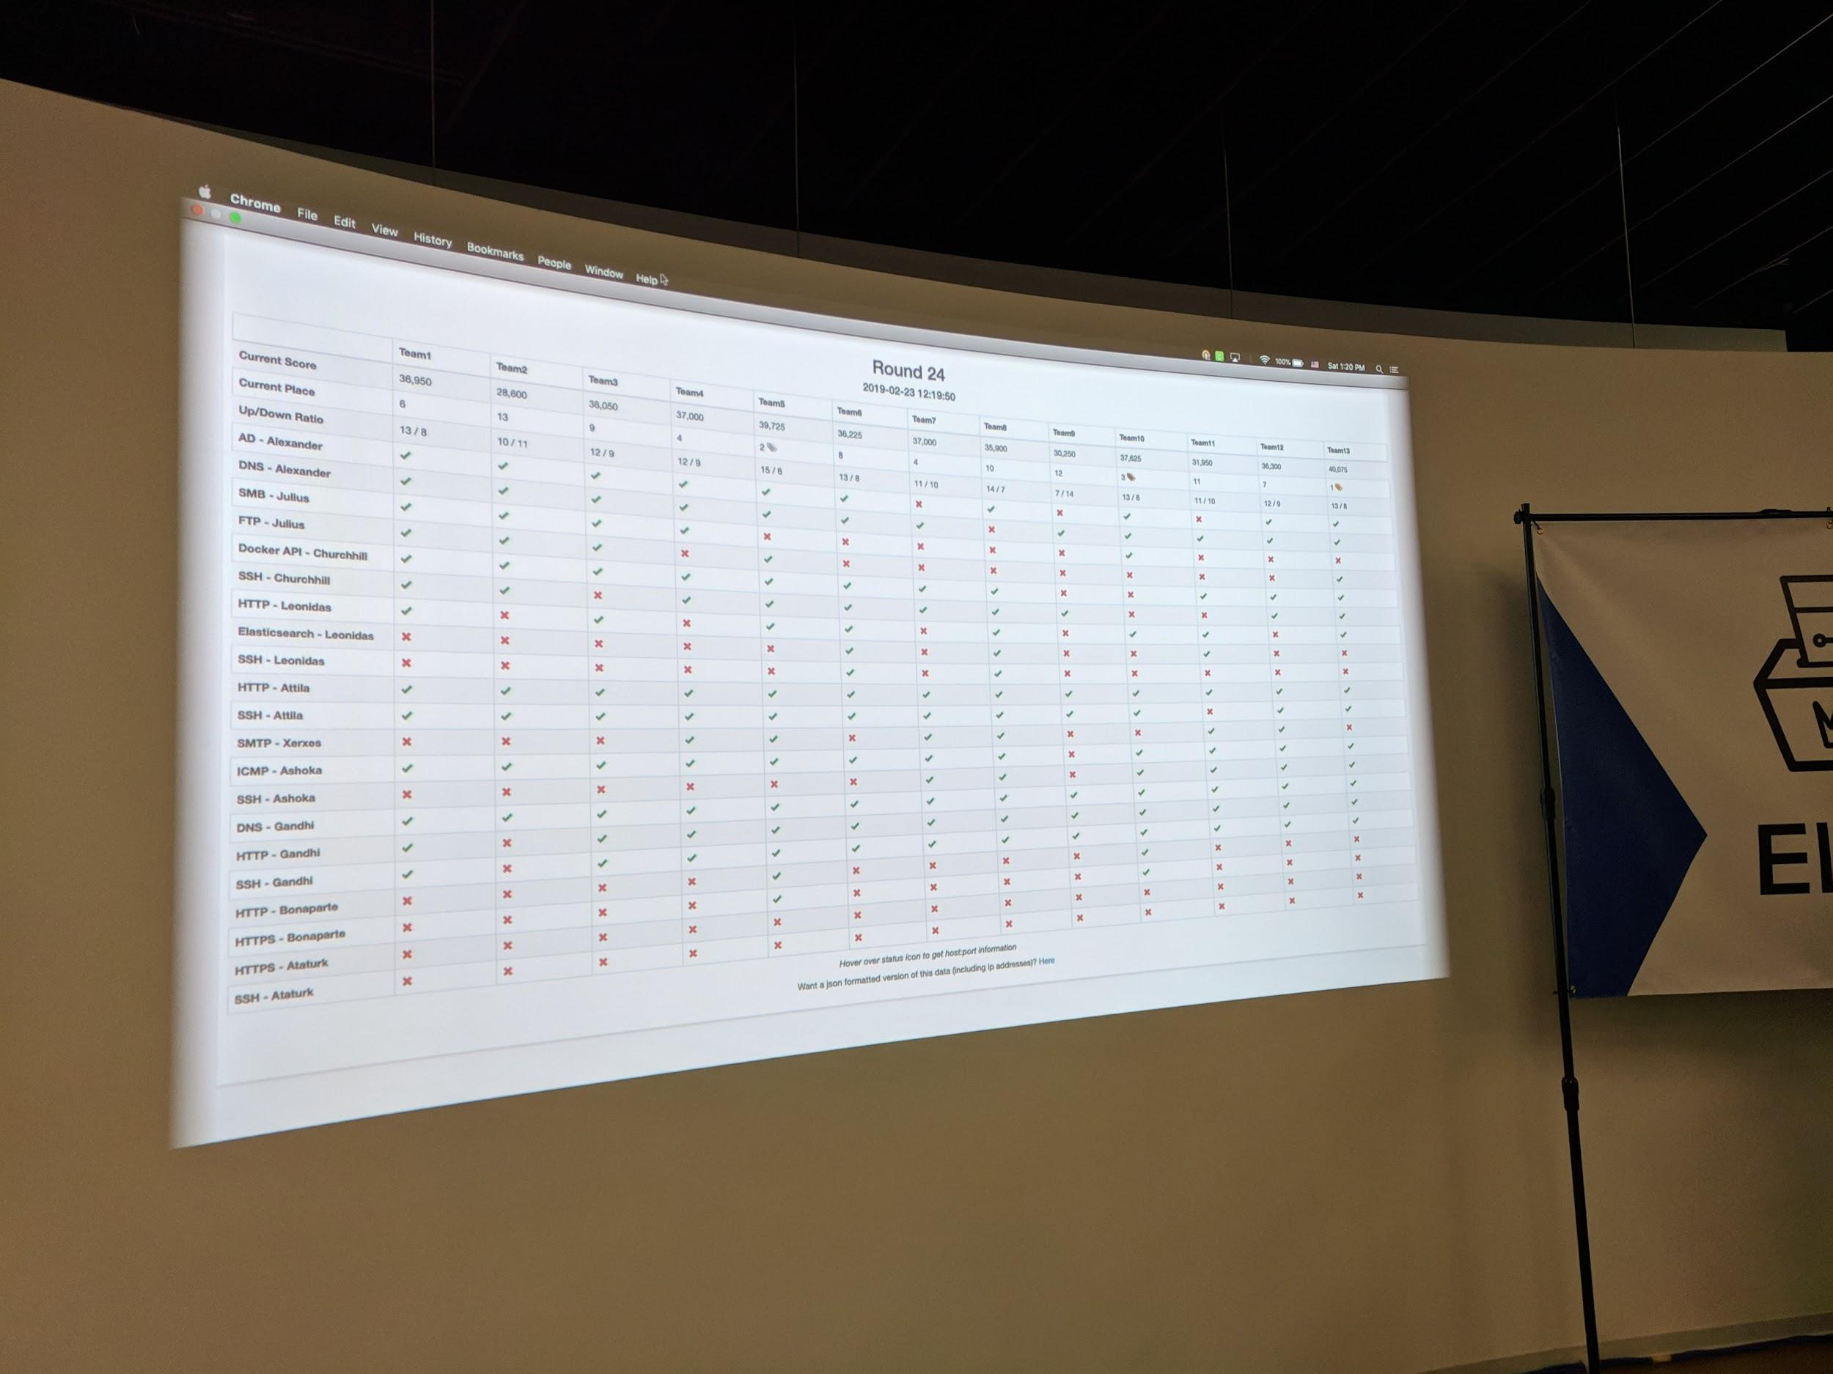
We went to a competition….
Information Security Talent Search 17 @Rochester Institute of Technology

Slide 3
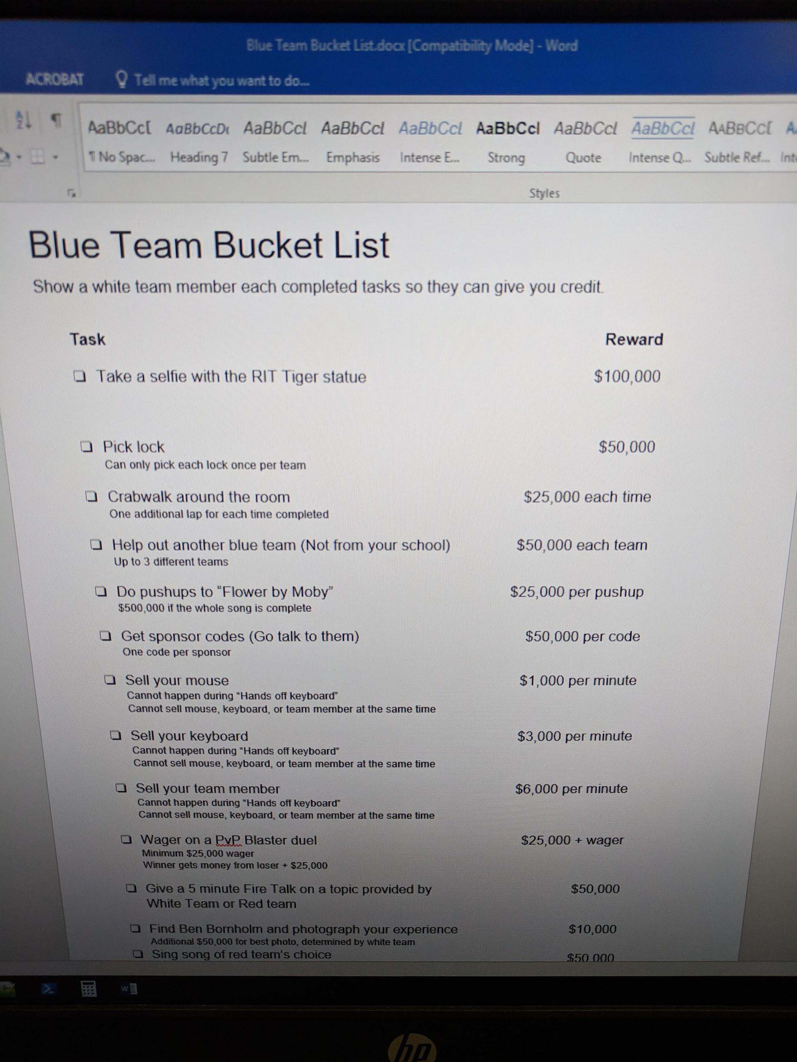
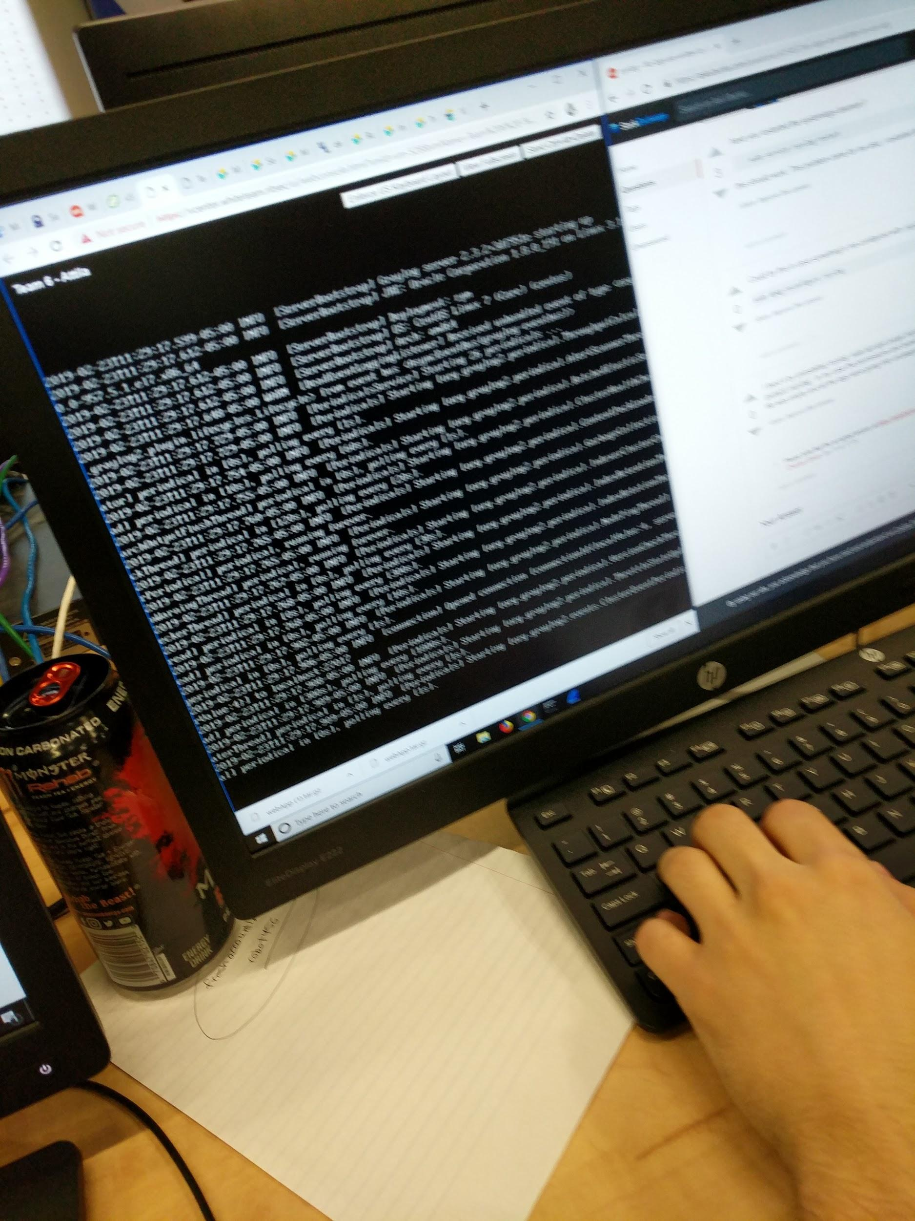
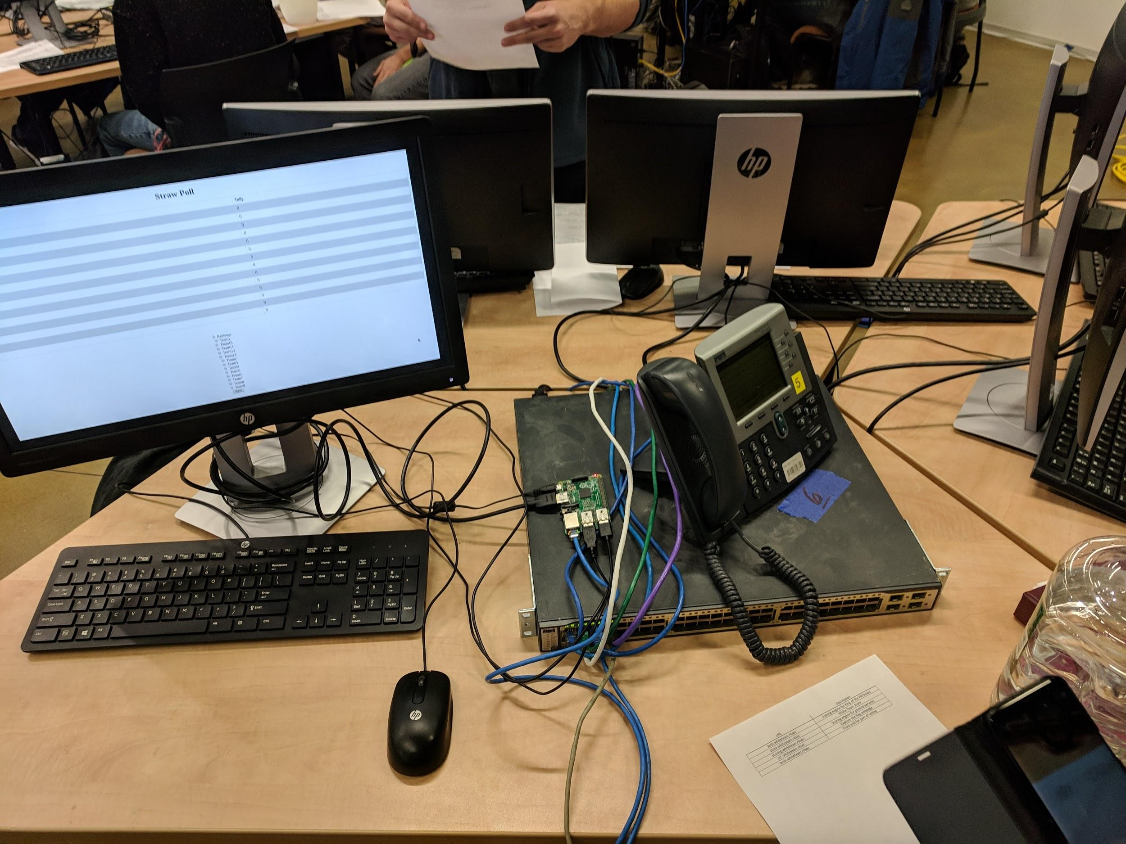
Some cool things that happened …
You can attack other team
2) You can call other teams
3) Lots of opportunities for points

Slide 4
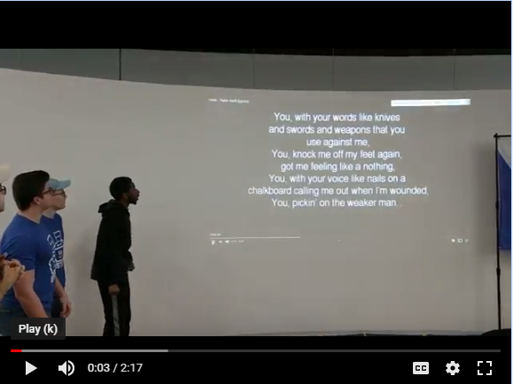
And we have video of it…
Video of us singing Mean by Taylor Swift to get access to our servers back

Slide 5

Upcoming competitions
Central New York Hackathon sign up soon!(THIS WEEK)
Beginner
Sign up soon on http://www.cnyhackathon.org/
DATES: Friday, April 5th, 4p to 9p
Saturday, April 6th, 9a to 5p

Slide 6
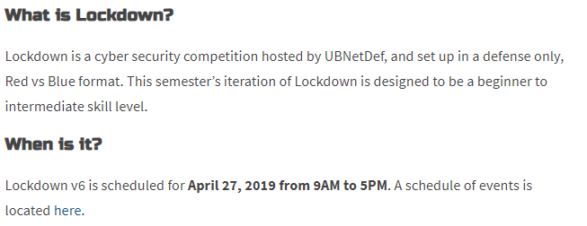

Upcoming competitions
Two teams
12 people total
University at Buffalo Lockdown v7

Slide 7

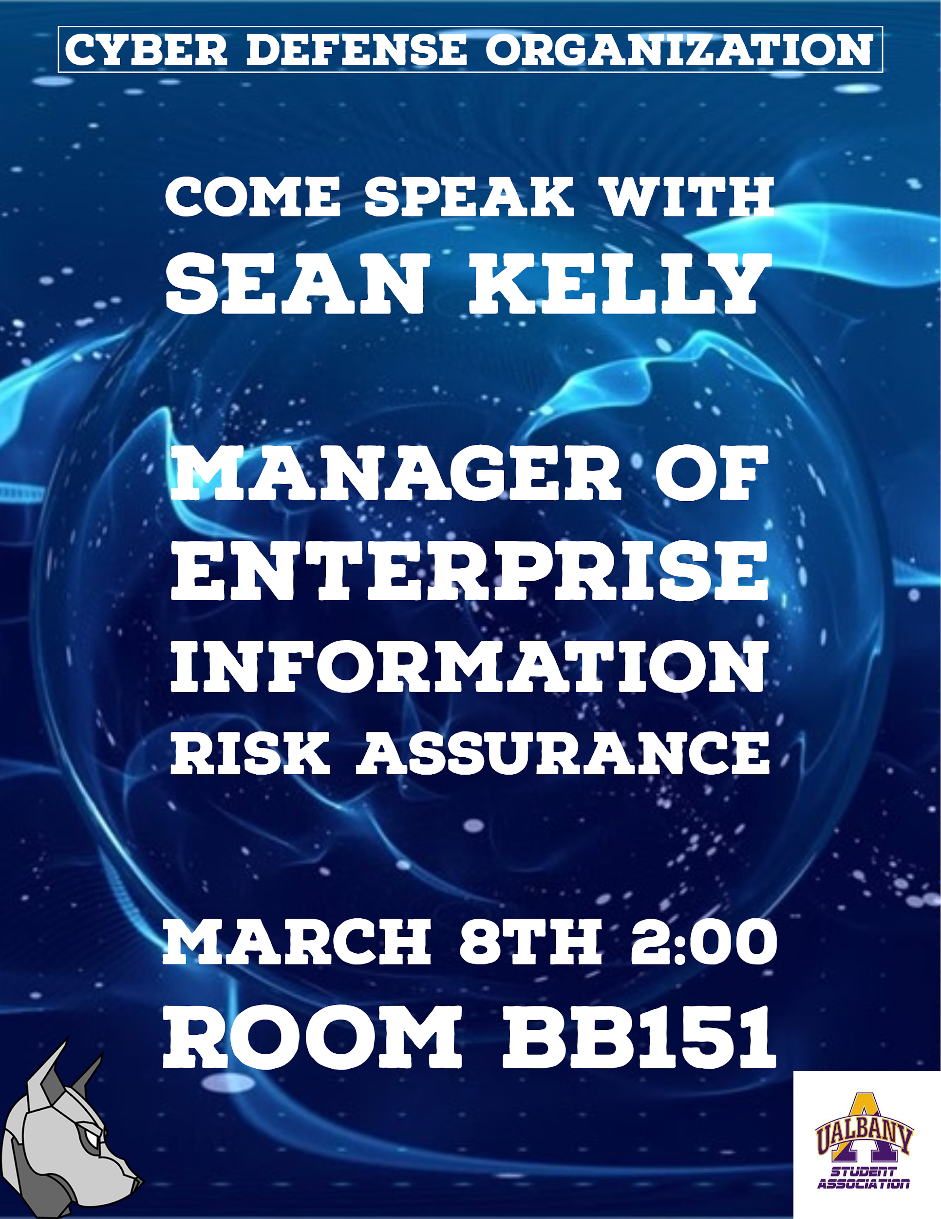
Guest Speaker Sean Kelly
Manager - Enterprise Information Risk Assurance at BlueCross BlueShield
MARCH 8th@2:00

Slide 8

Goals
What are Firewalls
Basic Networking concepts
How firewalls blocks traffic
Setting up Firewall Rules
Firewall OS Examples
Cisco Packet Tracer Hands on

Slide 9
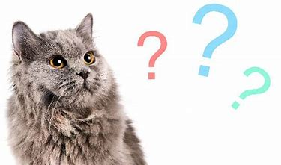
What are firewalls
The Overseer of the network
Fancy definition
a part of a computer system or network which is designed to block unauthorized access while permitting outward communication.
Most informed view of network traffic
Most firewalls double as a router (and sometimes not)

Slide 10
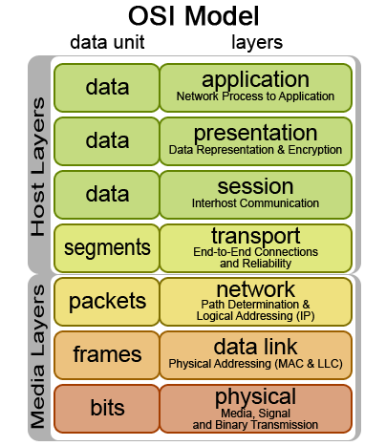
Packets in Networking
formatted unit of data carried by a packet-switched network
Also called payload
Packet switched network
Encapsulation

Slide 11
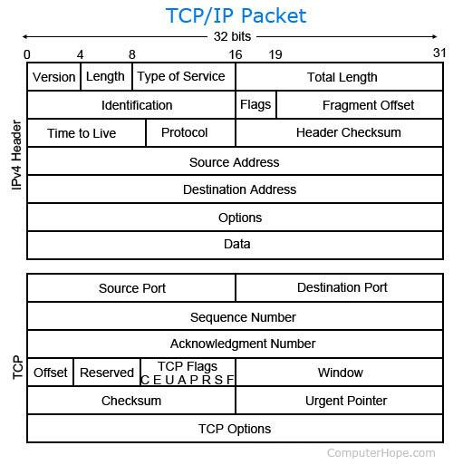
Information

Slide 12
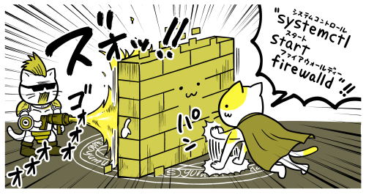
How Firewalls Block Traffic
Different layers of the packet have different pieces of data
The firewall has power of inspecting these layers
Information is power
Ports, Source IP address, and Destination IP Address,
Firewall rules
Reflection of network needs and organizational needs
Element that abuses this information
Takes extreme advantage of network functions

Slide 13



Firewalls Available today
Many available out there today:
PFSense
Palo Alto
Firewalld
Cisco ASA
And MORE

Slide 14
Let's Start the Fun Part!

Slide 15
Cisco packet Tracer walkthrough!

Slide 16

Step 1: Open up Cisco Packet Tracer
If you look on the desktop of the computer there should be an icon that looks like this:
Double Click!

Slide 17
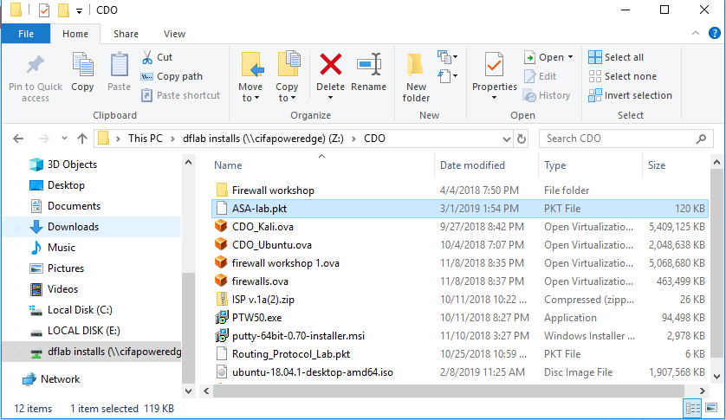
Step 2: Download the ASA-lab.pkt file

Slide 18
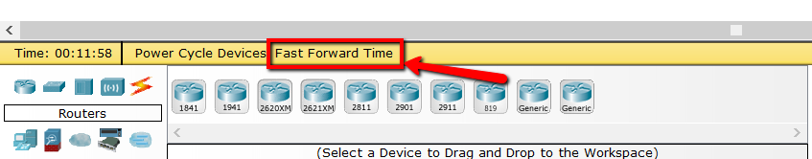
Step 3: We control Time!
Once you downloaded and opened the file we will control time
Please go to the bottom of the screen and click Fast-Forward time multiple times
Once the interfaces turn green you are good

Slide 19
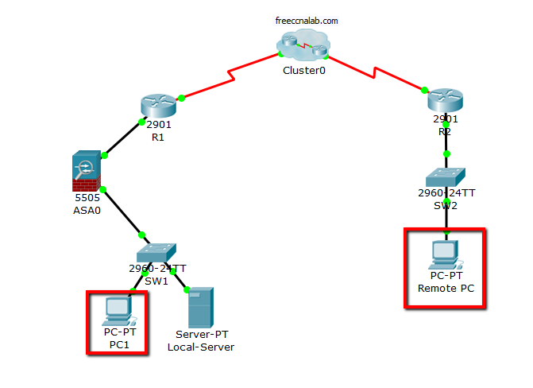
Step 4: Now we have access!
We will be begin with PC1 and Remote pc!
Double click to open them up

Slide 20
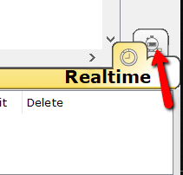
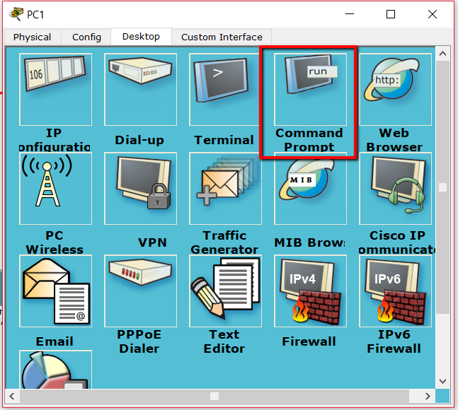
Step 5: See Traffic in the network
In the desktop tab click Command Prompt
Back on the cisco Packet tracer we need to switch to simulation mode
Click:

Slide 21
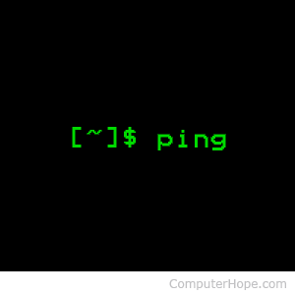
Step 6: Let's start pinging!
PC1
ping 192.168.1.1 (Firewall)
ping 206.165.200.225 (Gateway)
Remote PC
Ping 192.168.1.5 (Local PC)
One at a time!
Use Capture/Forward to watch the flow!

Slide 22
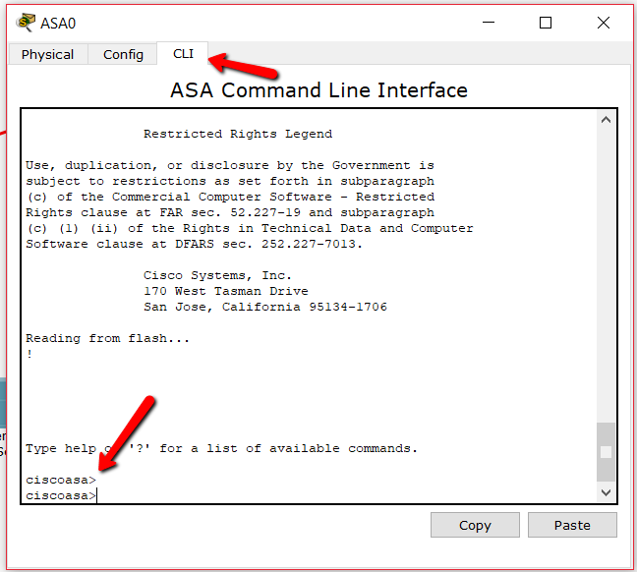
Step 7: It failed? Firewall Needs Fixing!
Double click the ASA Box
In the screen that opens choose CLI Tab
Type the below commands:
en <enter>
config t
access-list <Desired Name> extended permit icmp any any <Replace>
In replace do this 3 times for the following: echo, echo-reply, unreachable

Slide 23
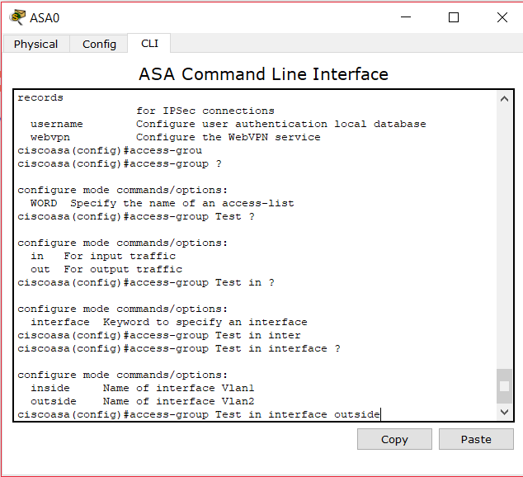
Step 8: Fixing Continued!
After finishing the other commands finally type this one:
access-group <Your ACL name> in interface outside
Last cmd: exit
Try it pinging again now! :)
DON’T CLOSE OUT YET

Slide 24
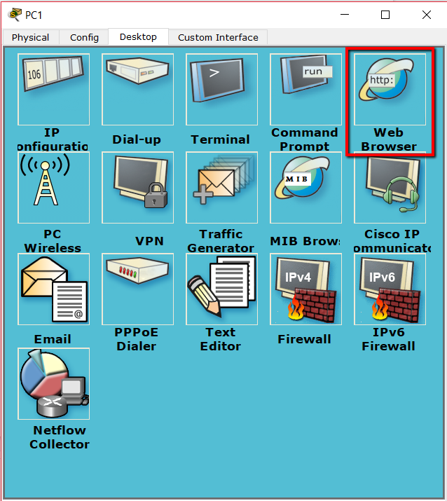
Step 9: There’s more!
Local PC should have access to a website named http://freeccnalab.com
Let’s head back to the desktop of the PC1 and this time choose Web Browser
Try accessing the website in simulation mode!

Slide 25
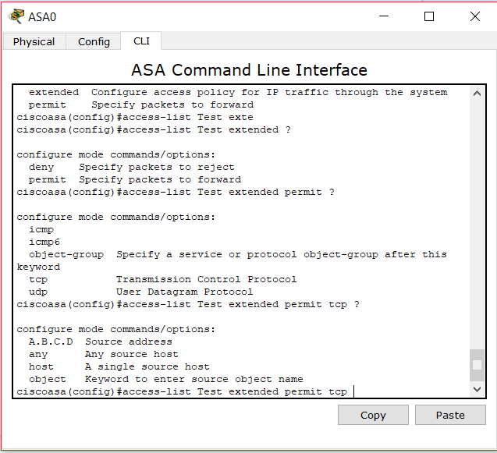
Step 10: It failed again! More fixes!
Sorry! I fail! Back to the ASA box CLI
Follow these commands:
en
config t
access-list <Previous name> extended permit tcp any any eq www
access-list <Previous name> extended permit tcp any any

Slide 26

Step 11: Your all good!
Your computer’s should be able to do what is required!

Slide 27
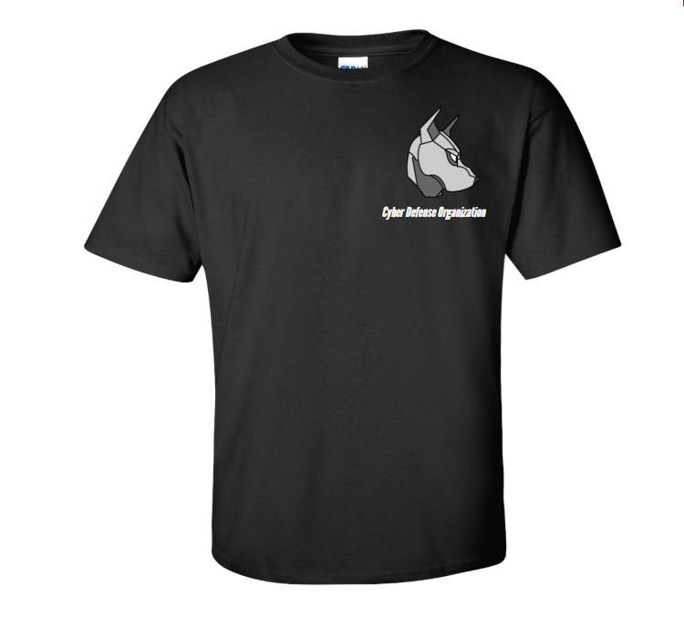
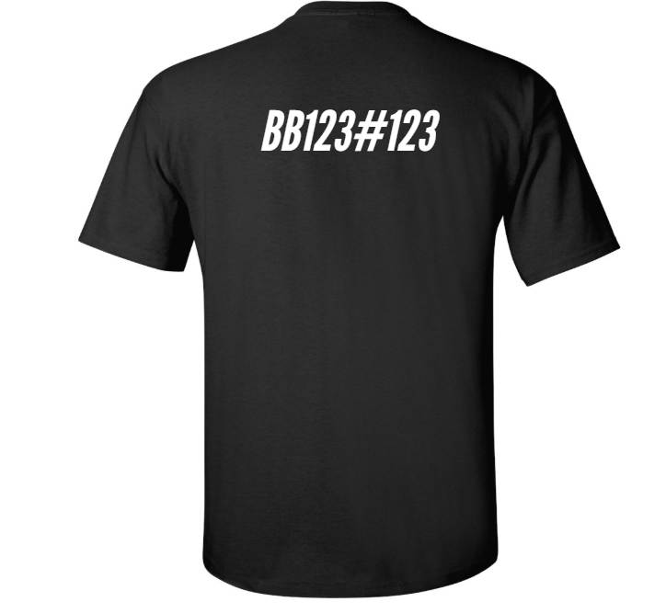
Please Buy A T-Shirt

Slide 28
Guest Speaker!
Sean Kelly, Enterprise Information Risk Assurance Manager for BlueCross BlueShield of Western New York.
Sean has served multiple roles in the fields of Information Security, Risk and Controls Assurance, Audit and Consulting at various companies.
Please come!

Slide 29

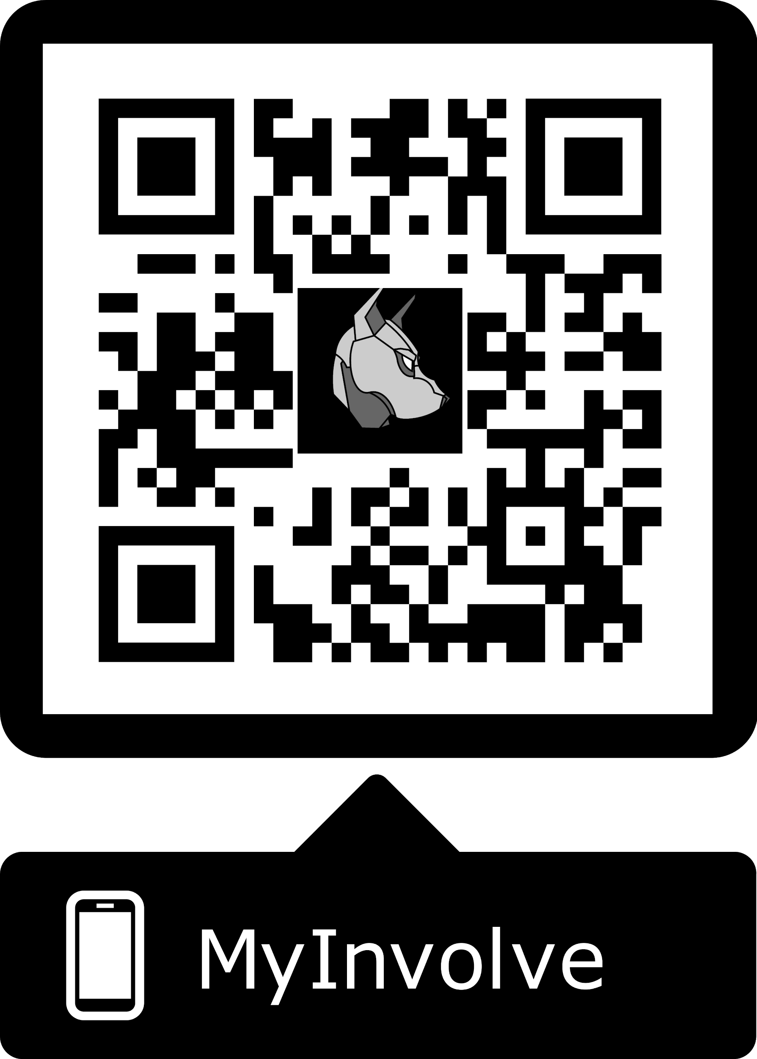
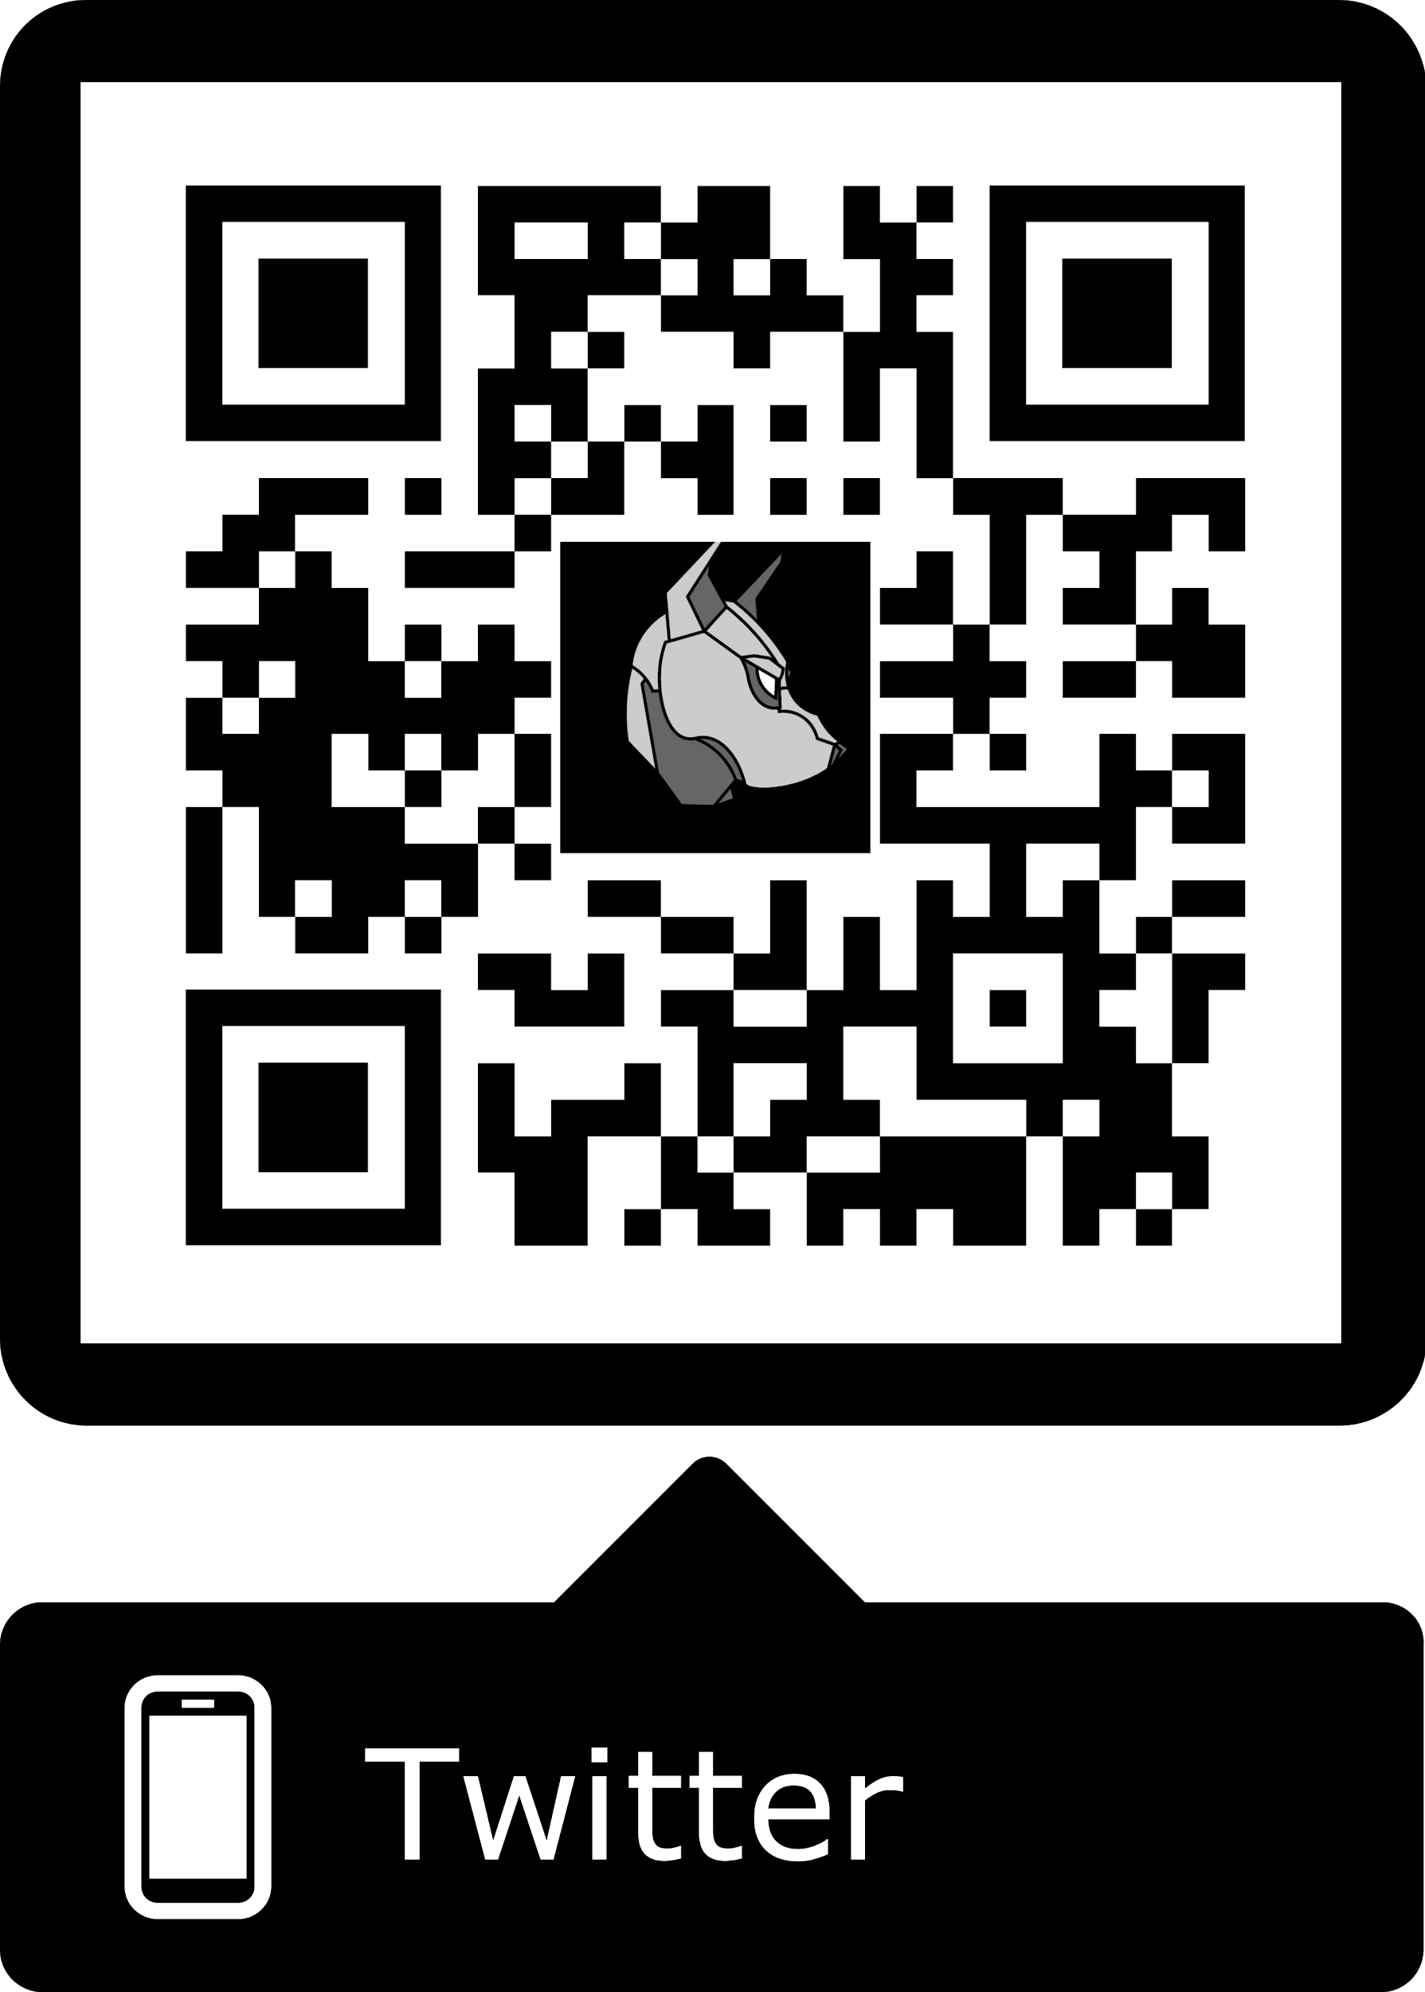
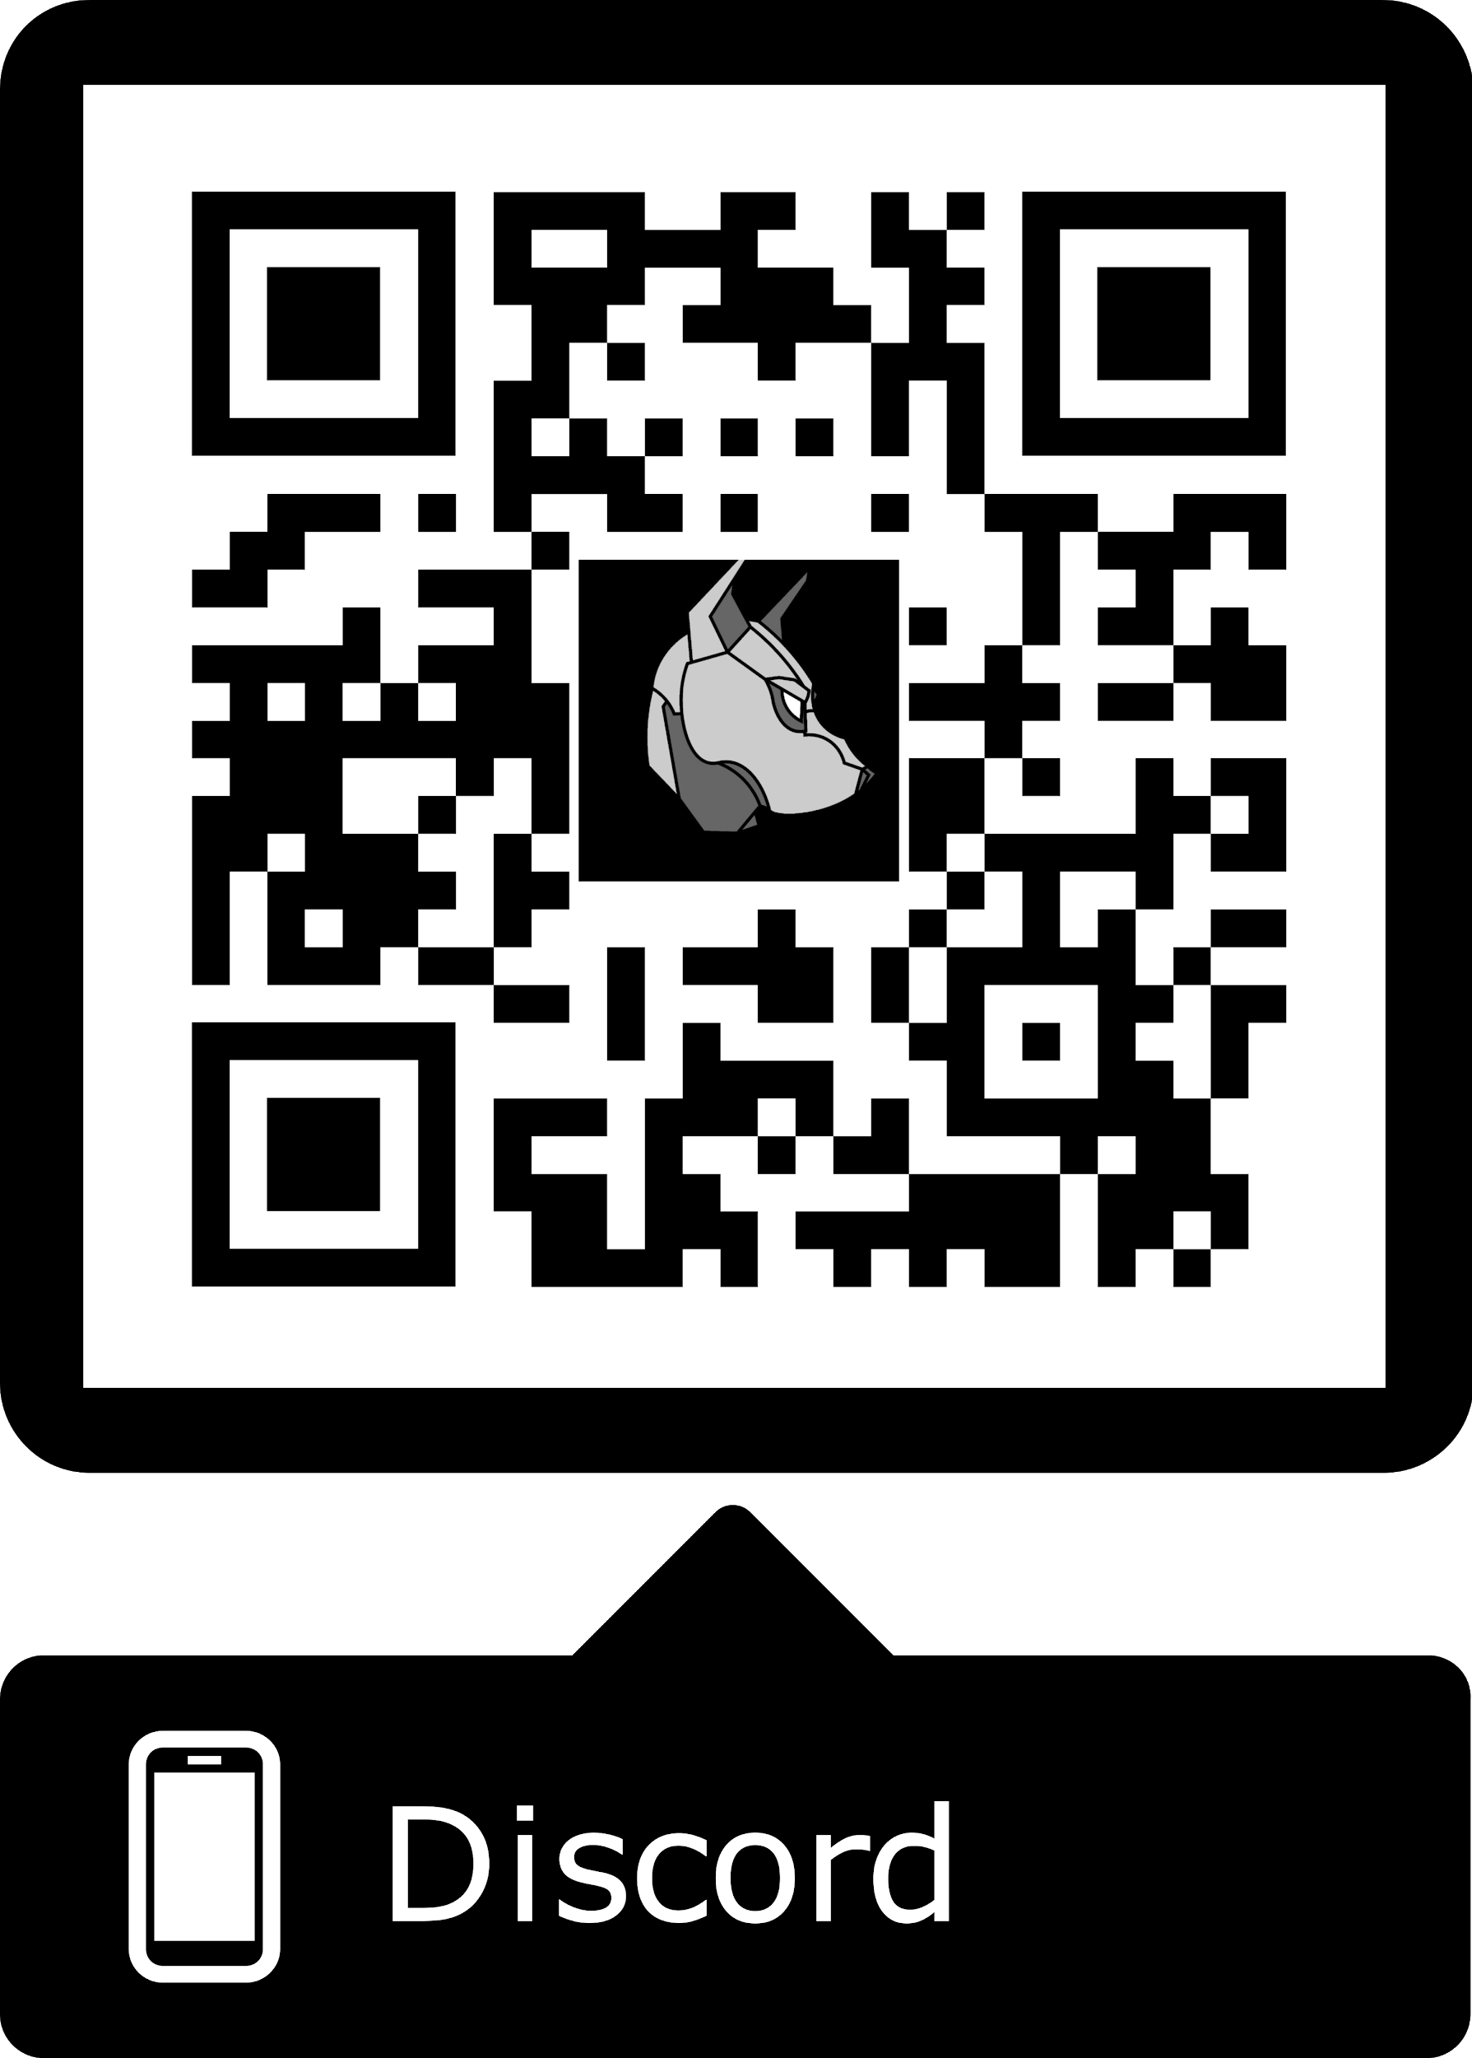
Cya Next week!
CertStudy - Tuesday, 7:15pm BB209
Thank you to everyone who filled out the survey!
We made a discord! Keep an eye on email.
Follow us on Twitter? Add on myInvolvement?
Sean Kelly - Friday - 2pm - BB151
March 5 - Jeffrey Baez - 7:30pm - Room TBA
https://discord.gg/9Dh6R5R

